Slide 1
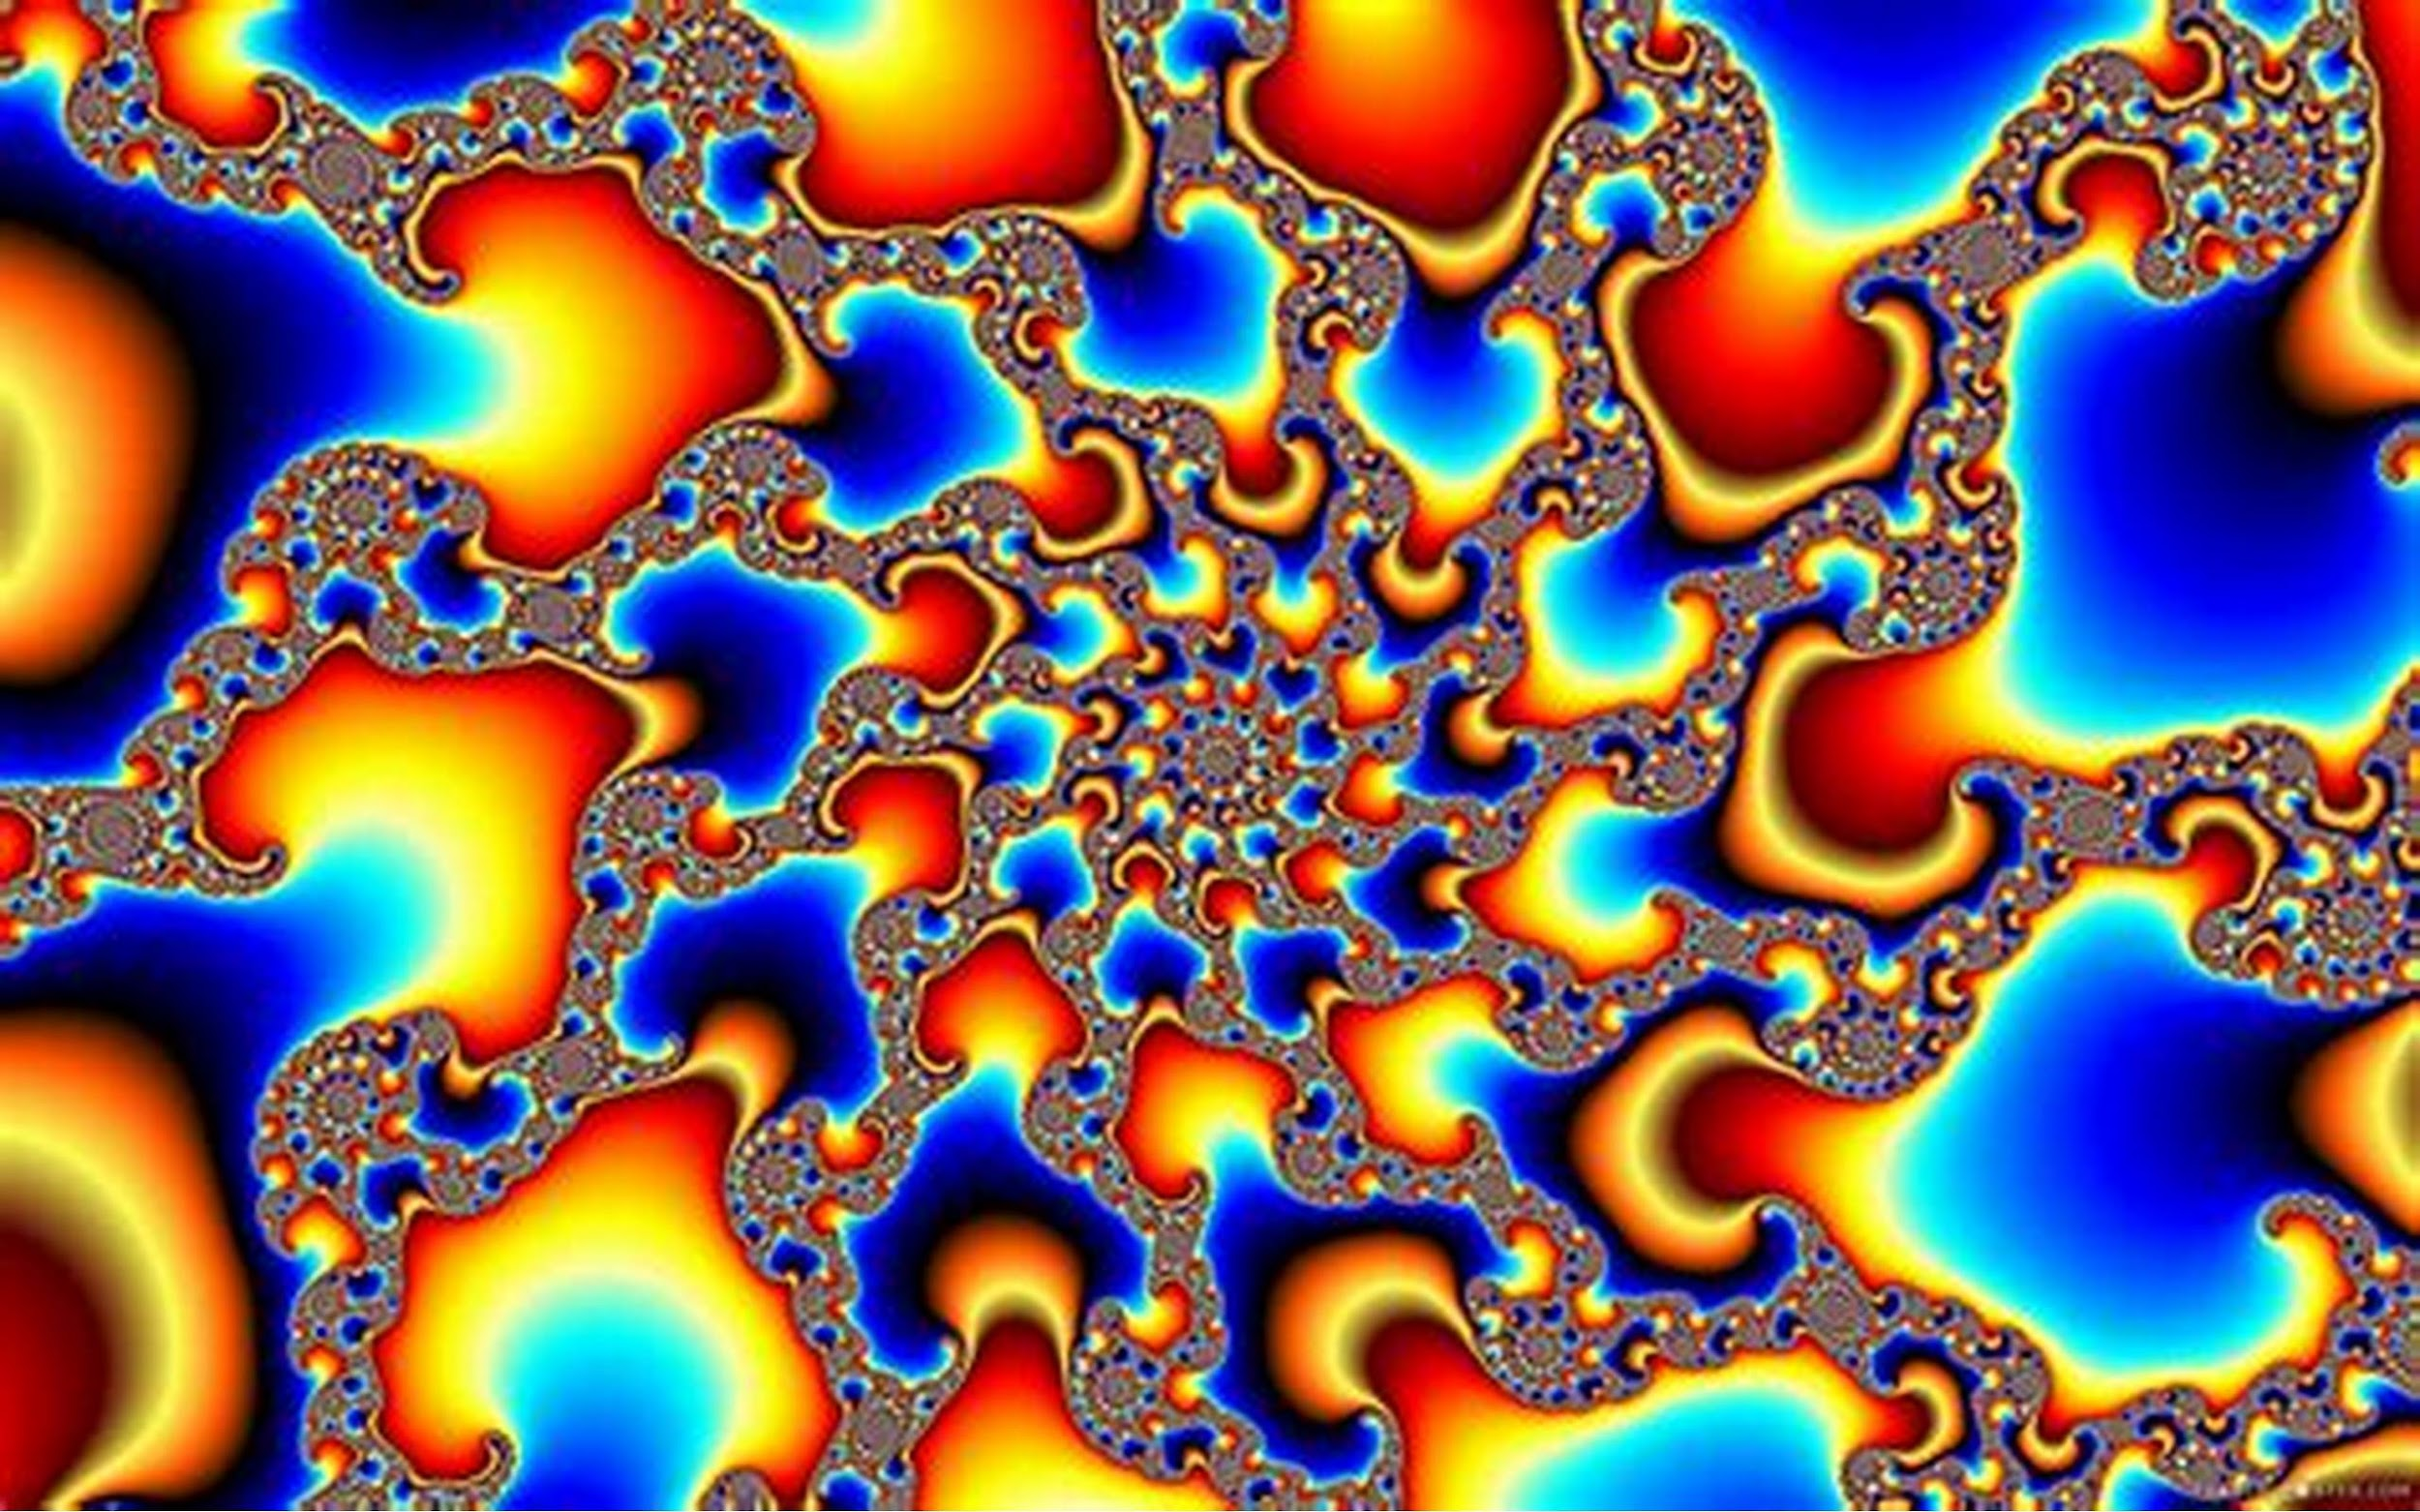
Kilobyte, Megabyte, and a Gigabyte
Leelynne Veverka-Cardwell

Slide 2
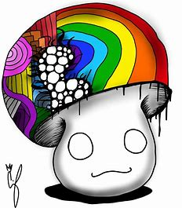

Kilobyte
Smallest Mushroom is the little brother that represents as Kilobyte. (Full of energy)

Slide 3
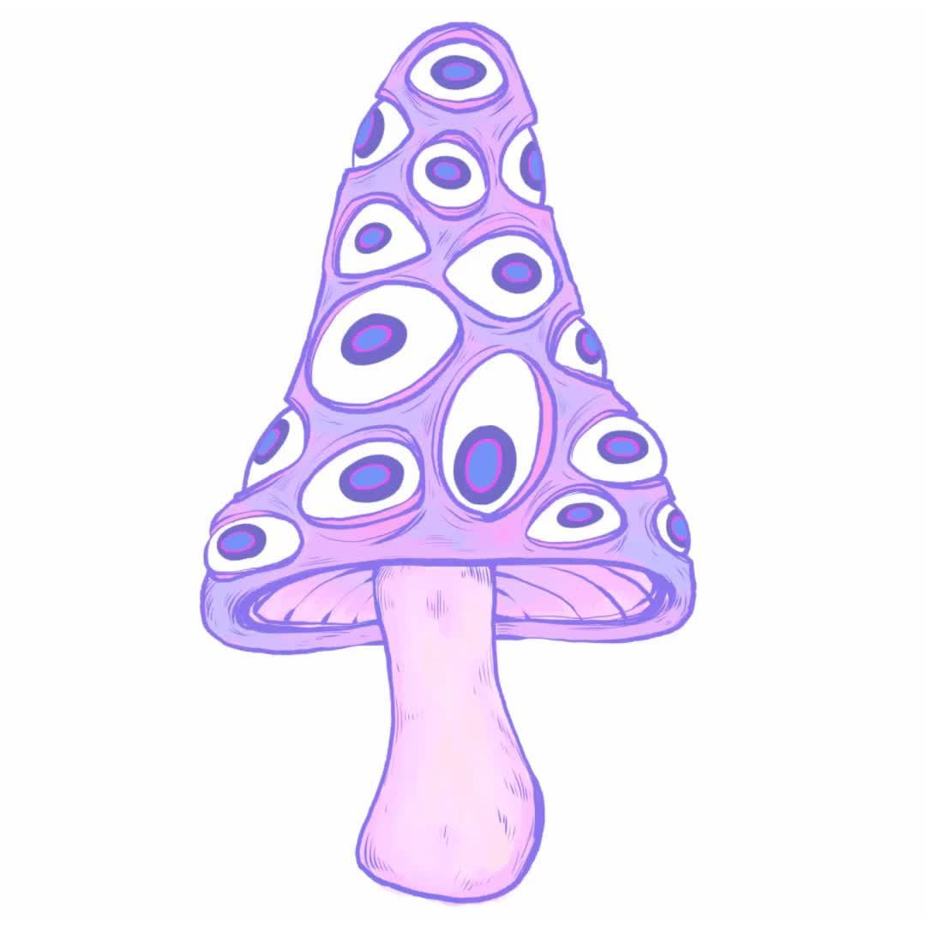
Megabyte
Middle Brother Mushroom who is the Medium size. Which represents Megabyte. (He got blessed with many eyes)

Slide 4
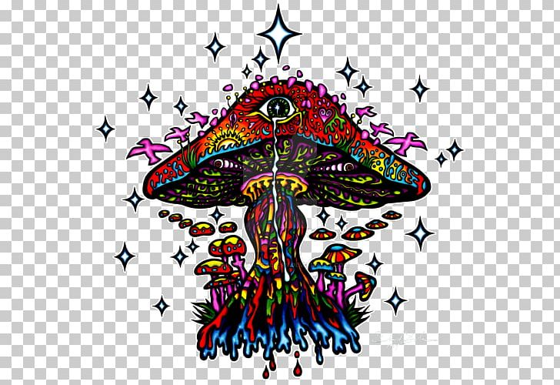
Gigabyte
She is the Gigabyte of the two
but that's because she is the older sister.
(She goes through emotions)

Slide 5

Little mushroom
He is the little brother who is full of energy but he is such a small guy. He can’t even be seen when he is behind his brother. Though don’t let the little guy fool you, he can make you wish you weren’t babysitting him. Though after a while his energy is full when he reaches his limit.

Slide 6

Middle Brother
He is the middle child but he is really quite. He can see things we can’t see from all directions at once. Though what he has that we don’t is the ability to see what happens in the future. Only downside is he can’t quite see to far but its far enough to were the world is different and everything has changed.

Slide 7

Older sister
The older sister has a lot of emotions since she can see everything and anything that can happen in life and death. She can see your past, future, and future—future. She has it all and it keeps going non-stop till she can’t no more. Though who knows when that’ll end.

